Slide 1
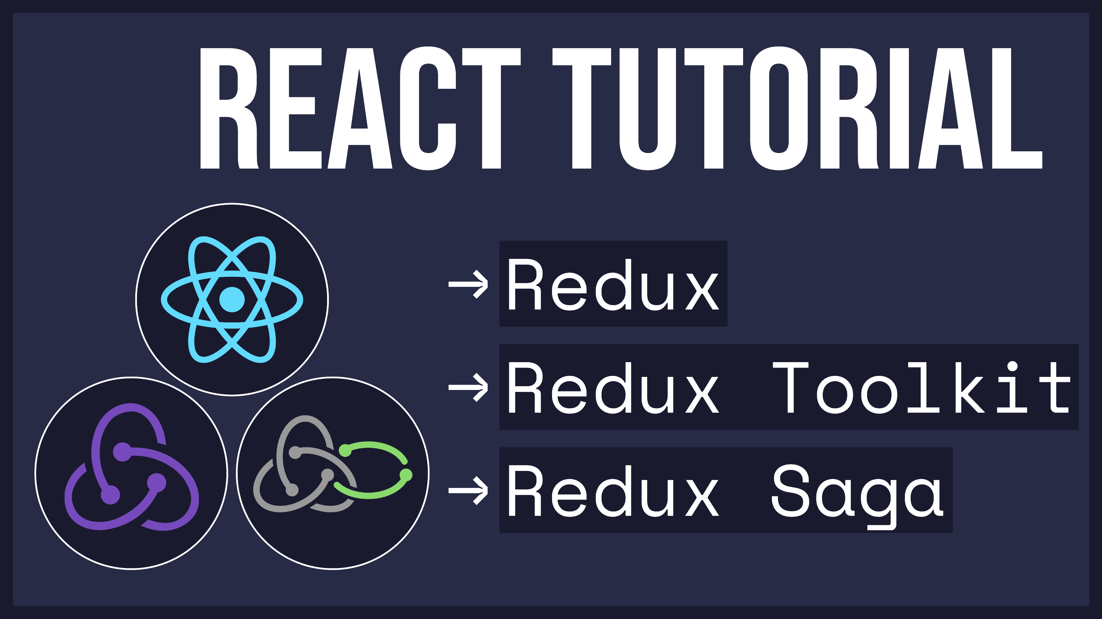

Slide 2

Introduction to Redux
Concepts and Data Flow

Slide 3
🤔 What is Redux?
💡 Redux allows you to manage your app’s state in a single place

Slide 4
😀 When to Use Redux?
You have large amounts of application state that are needed in many places in the app
The app state is updated frequently
The logic to update that state may be complex
The app has a medium or large-sized codebase, and might be worked on by many people
You need to see how that state is being updated over time

Slide 5
😔 Redux Drawbacks
There are more concepts to learn, and more code to write…

Slide 6
👨‍🏫 Redux Concepts
1) Store
Redux application state lives in an object called the store

Slide 7
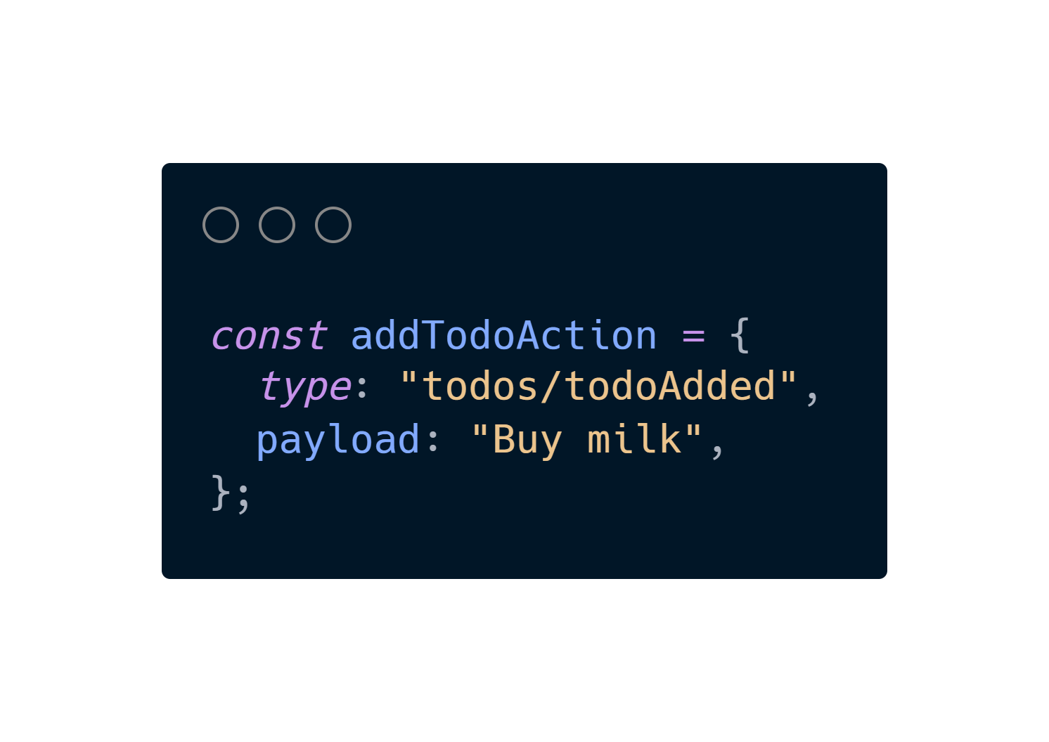
👨‍🏫 Redux Concepts
2) Action
The actions (events) that occur in the app based on user input, and trigger updates in the state
An action is a plain JavaScript object that typically has the following fields:
- type: string that gives this action a descriptive name
- payload: additional information about what happened

Slide 8
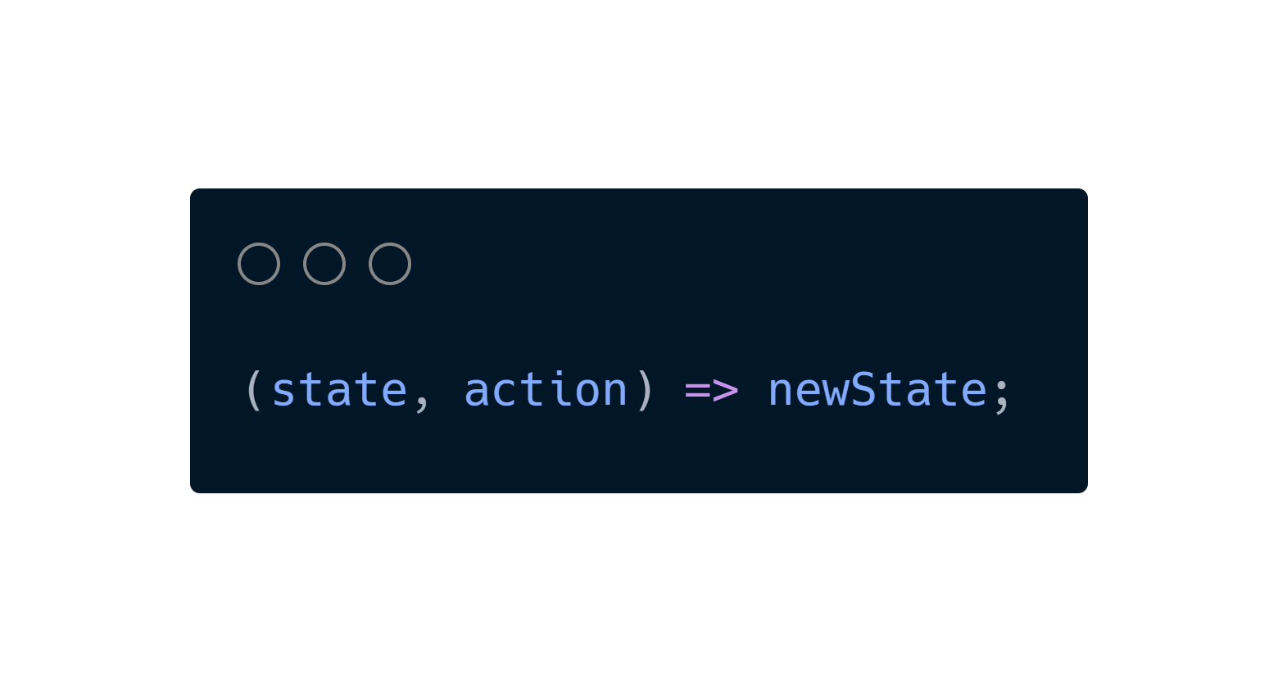
👨‍🏫 Redux Concepts
3) Reducer
A reducer is a function that receives the current state and an action object, then decides how to update the state.
You can think of a reducer as an event listener which handles events based on the received action (event) type.

Slide 9
🧠 Redux Data Flow

Slide 10
Redux Toolkit
Overview

Slide 11
🤔 What is Redux Toolkit?
The Redux Toolkit package is intended to be the standard way to write Redux logic.
💡 In essence, it makes writing Redux logic much easier.

Slide 12
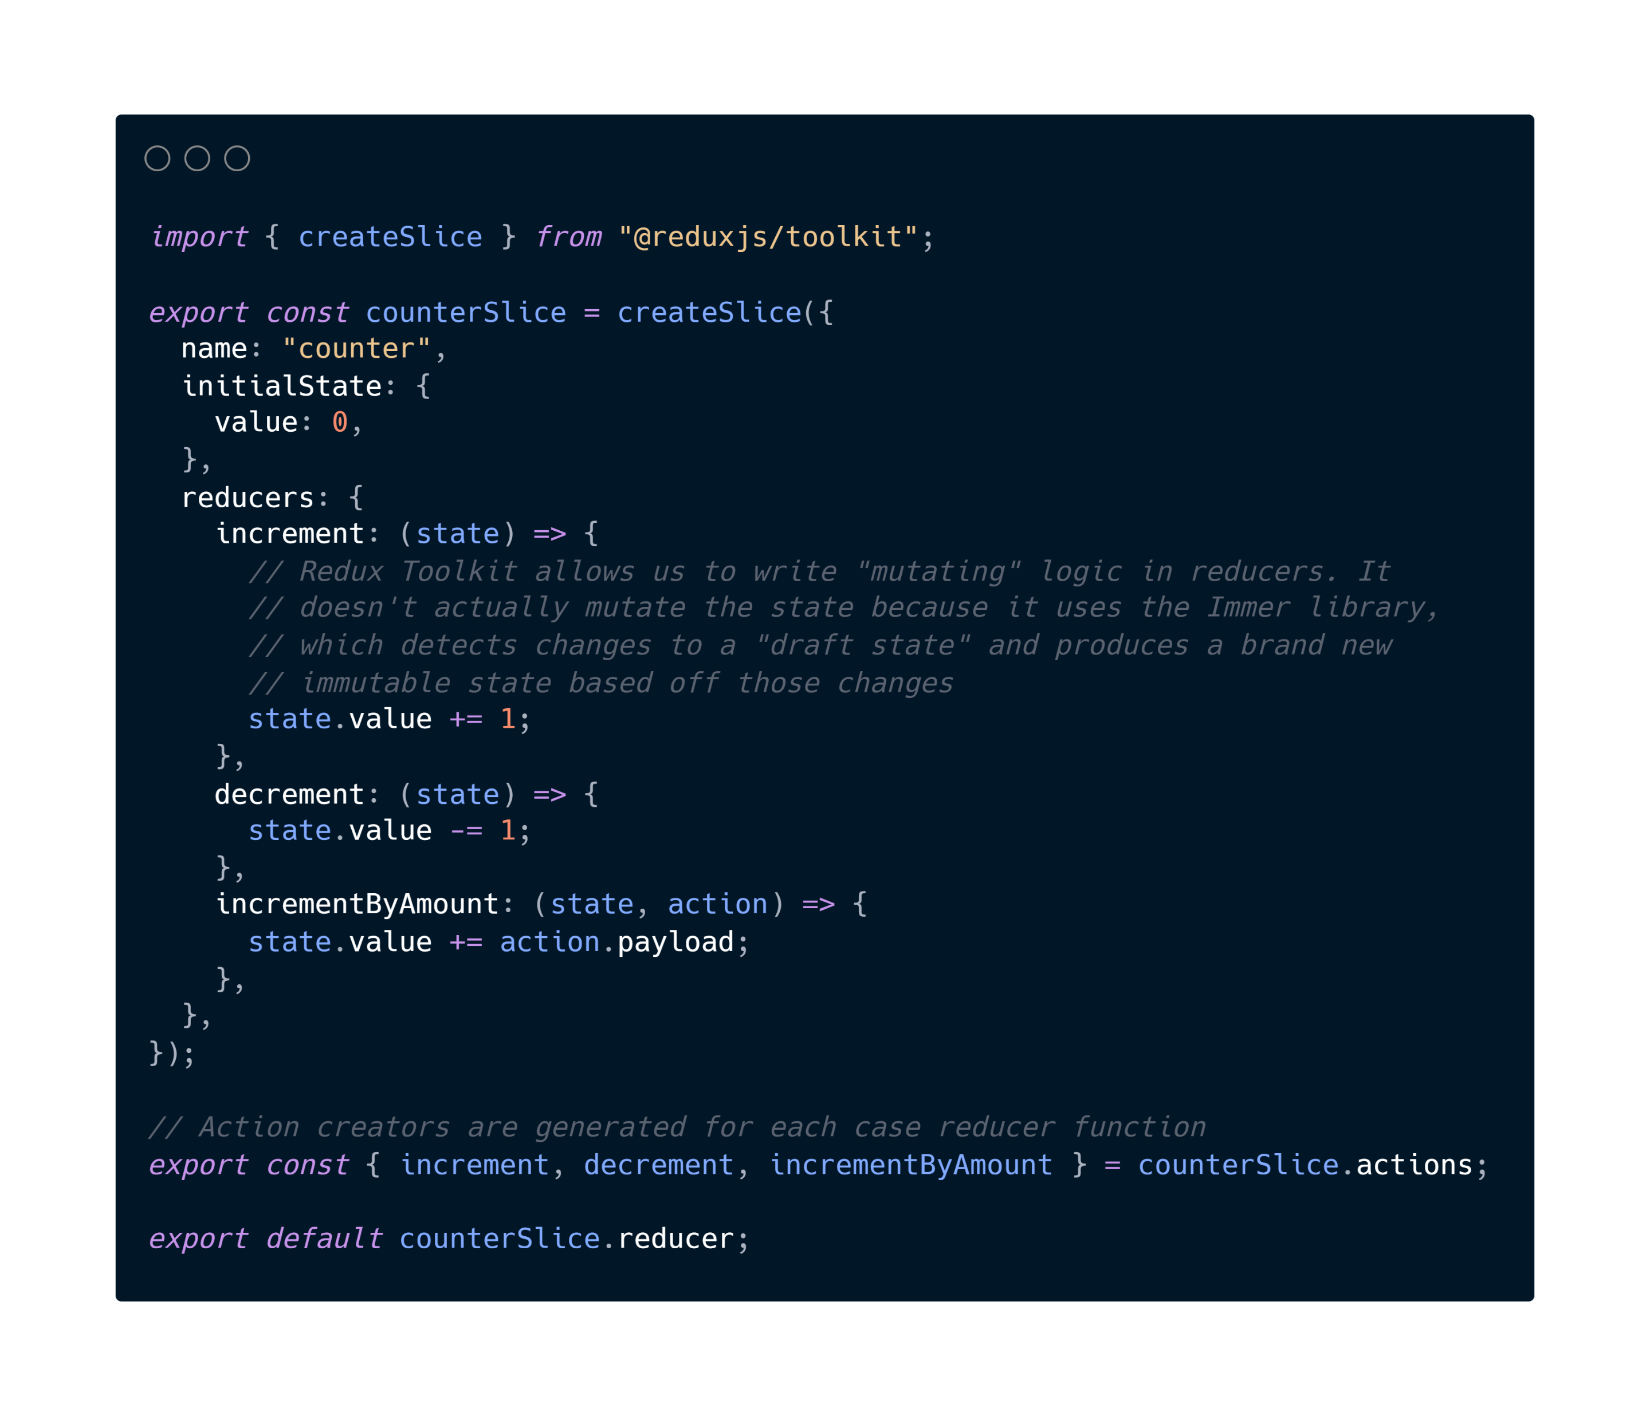
🍕 Redux Slice

Slide 13

Redux Saga
Overview

Slide 14
🤔 What is Redux Toolkit?
Redux Saga is a Redux Middleware.
💡 In essence, it is a tool to help us manage asynchronous tasks, such as data fetching!

Slide 15
🧠 Redux Data Flow
(with middleware)
Notes:
So how do middleware and async logic affect the overall data flow of a Redux app?
Just like with a normal action, we first need to handle a user event in the application, such as a click on a button.
Then, we call dispatch(), and pass in something, such as a plain action object.
Once that dispatched value reaches a middleware, it can make an async call, and then dispatch an action when the async call completes.
💡 To summarize, when we add async logic to a Redux app, we add an extra step where middleware can run logic like data fetching requests, then dispatch actions.

Slide 16
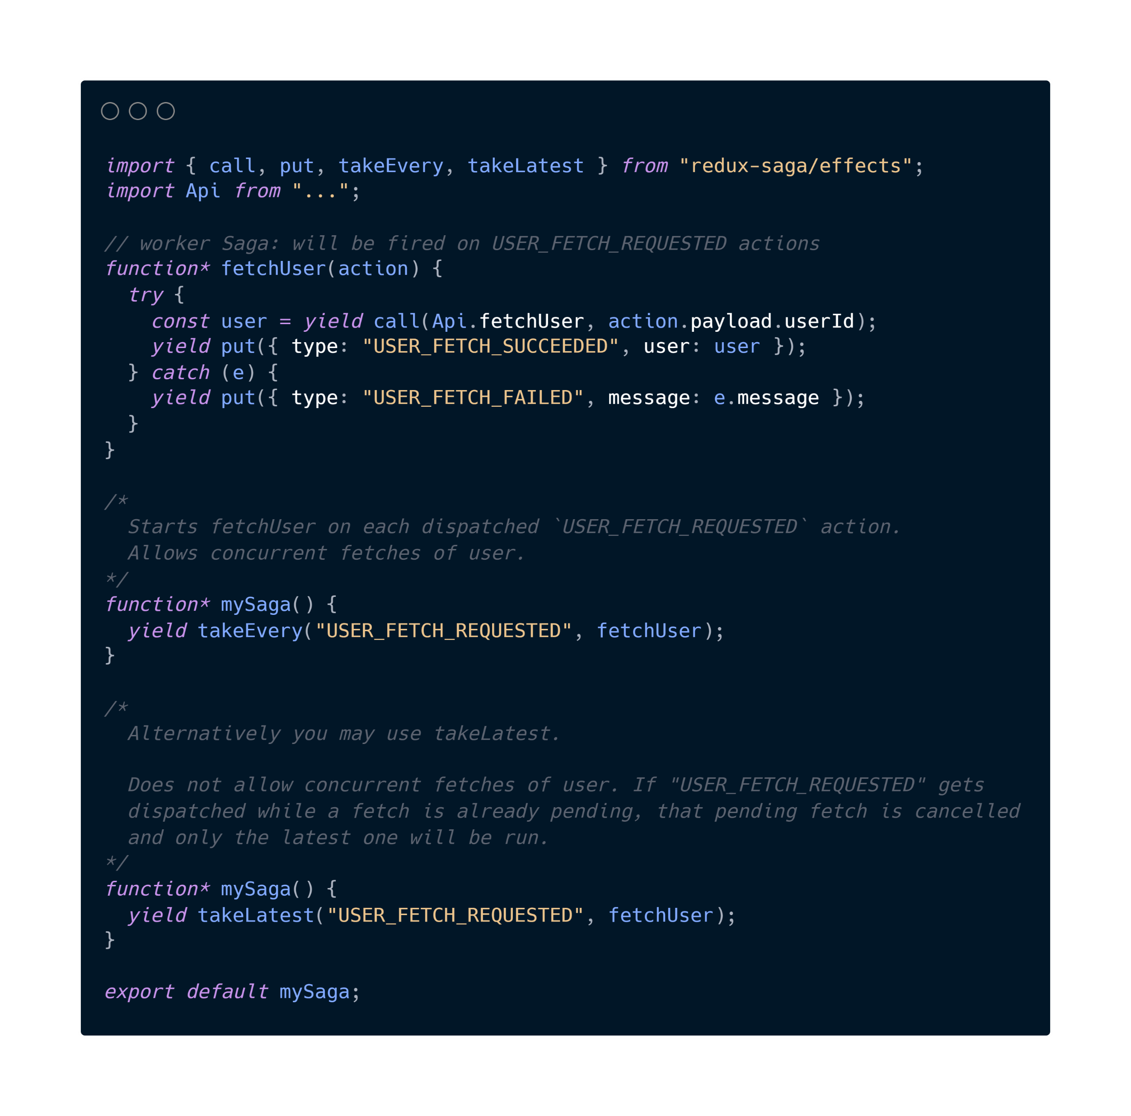
🕵️ Watchers + 👷 Workers
👷 worker
🕵️ watcher
🕵️ watcher
Notes:
Two main components of Redux Saga include the following:
Watcher Saga will watch for dispatched actions and fork a worker
Worker Saga will handle the action and terminate
Let’s take a look at this example. I’ll explain more of the details later on, so don’t worry if you don’t understand everything at first.
The watcher sagas will look out for the “USER_FETCH_REQUESTED” action. When it picks one up, it will fire the “fetchUser” worker saga.
The worker saga is what actually does the “work”. Typically, this will involve making a REST API call, and then updating the state with the response.
In a worker saga

Slide 17
Let’s Practice!
By Building a “To Do” App

